Slide 1
Life Expectancy
A statistical analysis on the factors influencing Life expectancy
-Amruta M Menon

Slide 2
Contents
Objective
About the data
Data Description
Analysis
Visualization
Conclusion

Slide 3
Objective

Slide 4
Objective
The objective here is to find the factors that affect the Life Expectancy from the year 2000-2015.

Slide 5
About the data

Slide 6
About the data
Dataset was collected from Kaggle – Life Expectancy by WHO.
Contains different immunization, mortality, economic, social and other health related factors influencing Life Expectancy.
Effect of immunization, Human Development Index, GDP, Population etc. are some of them.

Slide 7
Data description

Slide 8
Data description
Dataset contains 22 columns and 2938 rows.
Column details:
Country : Names of 193 Countries.
Year : Years from 2000-2015 was taken into account.
Status : Status of a Country: Developing and Developed.

Slide 9
Life expectancy : Life expectancy in age.
Adult Mortality : Adult Mortality Rates of both sexes (probability of dying between 15 and 60 years per 1000 population).
Infant Deaths : Number of Infant Deaths per 1000 population.
Alcohol : Alcohol, recorded per capita (15+) consumption (in litres of pure alcohol).

Slide 10
Percentage Expenditure : Expenditure on health as a percentage of Gross Domestic Product per capita(%).
Hepatitis B : Hepatitis B (HepB) immunization coverage among 1-year-olds (%).
Measles : Measles - number of reported cases per 1000 population.
BMI : Average Body Mass Index of entire population.

Slide 11
Under-five Deaths : Number of under-five deaths per 1000 population.
Polio : Polio (Pol3) immunization coverage among 1-year-olds (%).
Total expenditure : General government expenditure on health as a percentage of total government expenditure (%).
Diphtheria : Diphtheria tetanus toxoid and pertussis (DTP3) immunization coverage among 1-year-olds (%).

Slide 12
HIV/AIDS : Deaths per 1000 live births HIV/AIDS (0-4 years).
GDP : Gross Domestic Product per capita (in USD).
Population : Population of the country.
Thinness 1-19 years : Prevalence of thinness among children and adolescents for Age 10 to
19 (%).

Slide 13
Thinness 5-9 years : Prevalence of thinness among children for Age 5 to 9(%).
Income composition of resources : Human Development Index in terms of income composition of resources (index ranging from 0 to 1).
Schooling : Number of years of Schooling(years).

Slide 14
Analysis

Slide 15
analysis
Analysis based on the target variable – Life Expectancy:
What are the average life expectancies of each country from 2000-2015?
Does the alcohol consumption affect the life expectancy of people?
According to 2015, which country has the highest life expectancy?
Do densely populated countries tend to have lower life expectancy?
What is the impact of Immunization coverage on life Expectancy?
What is the impact of schooling on the lifespan of humans?

Slide 16
Should a country having a lower life expectancy value(< 65) increase its healthcare expenditure in order to improve its average lifespan?
What can we say about the life expectancy of a country having BMI>30?
Other Analysis:
Infant death in India during 2000-2015.
How GDP affect the status of a country?
What can one say about the average Infant deaths in developing and developed countries?
What are the rate of schooling in India from 2000-2015?

Slide 17
Which country has the highest infant death in the year 2015?
Which developing country has the least immunization and which developed country has the highest immunization?
What are the percentage of immunization coverage in India from 2000-2015?

Slide 18
Visualization

Slide 19
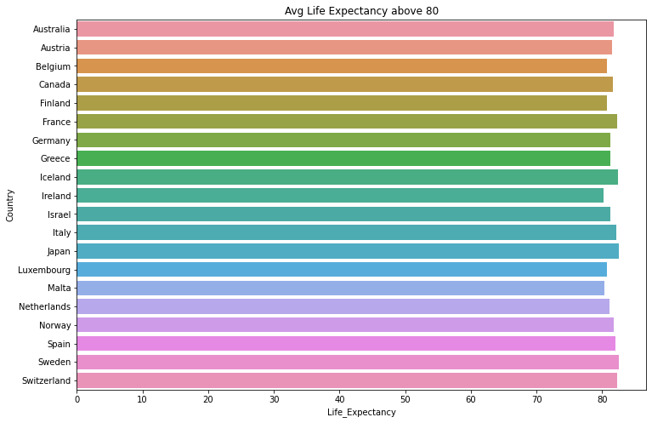
Countries with average life expectancy above 80

Slide 20
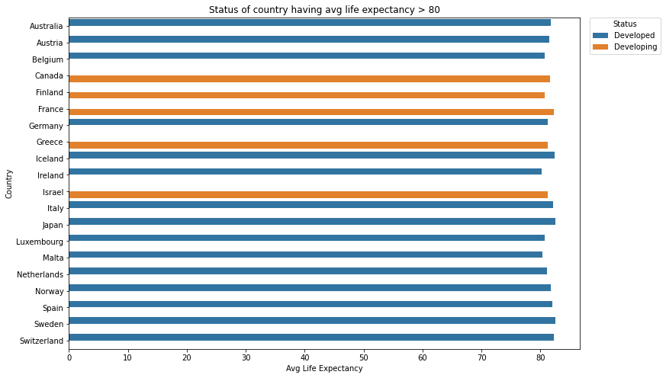
Status of country having average life expectancy > 80

Slide 21
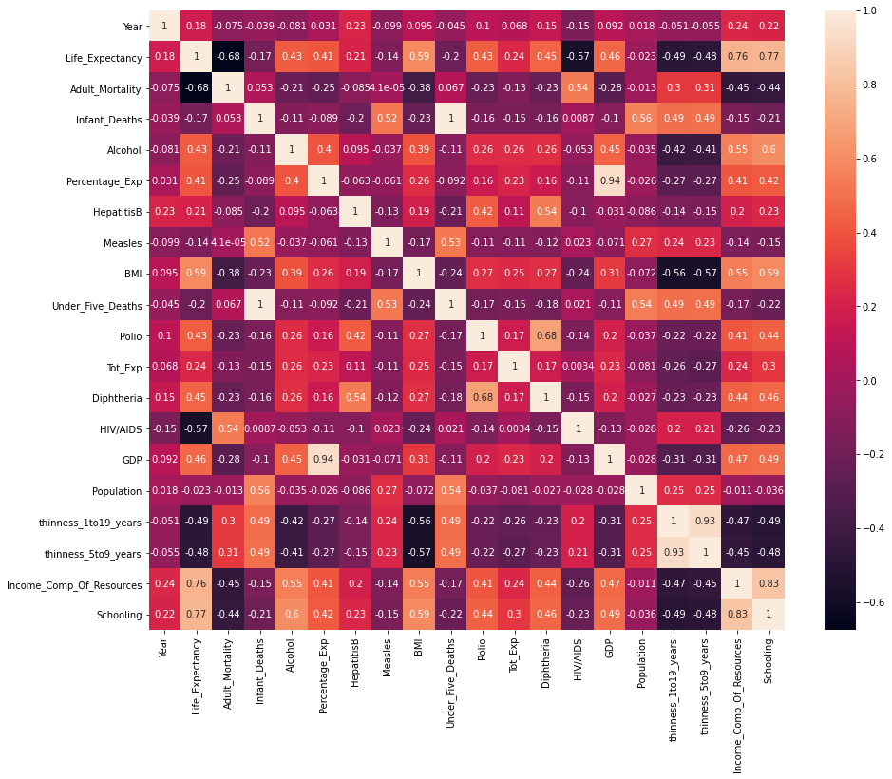
Alcohol consumption and life expectancy

Slide 22
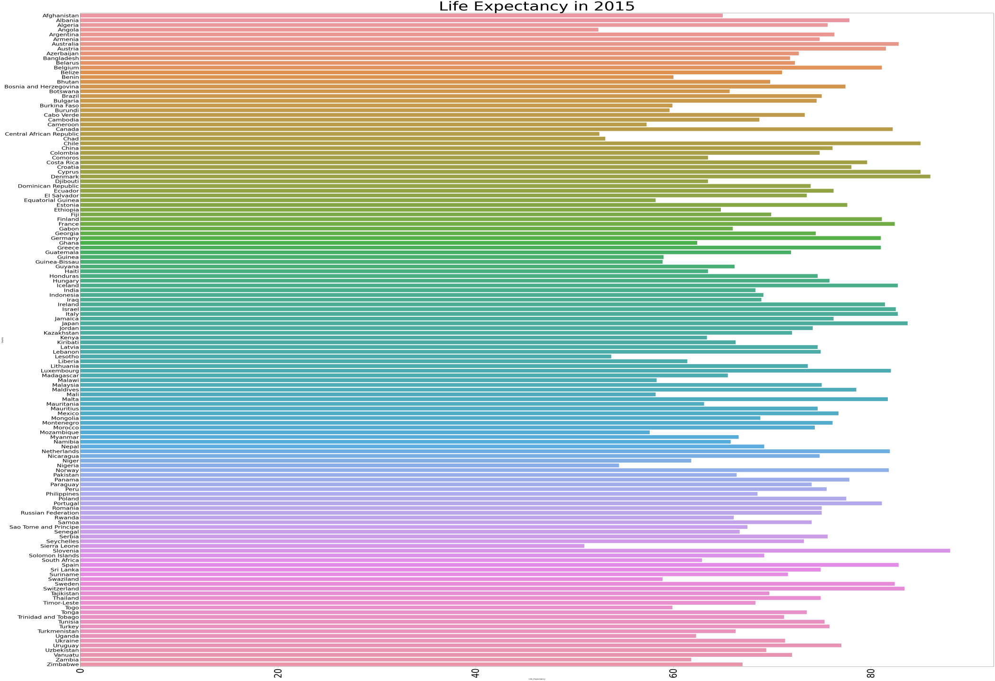
Countries with highest Life expectancy in 2015

Slide 23
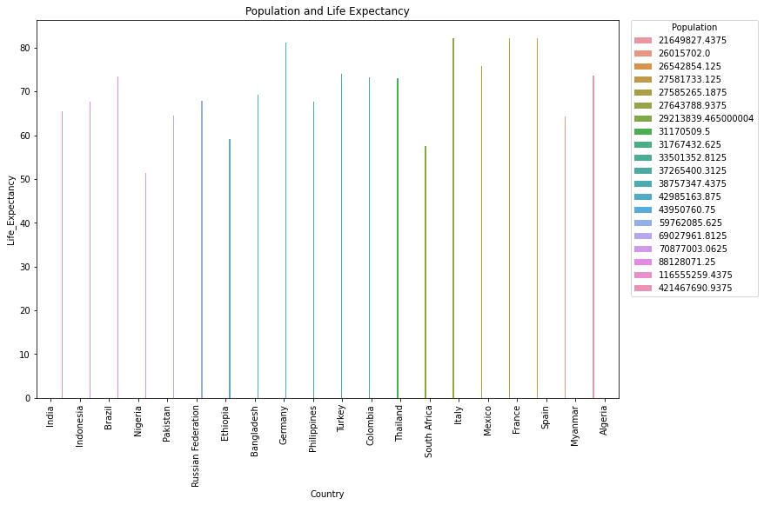
Population and life expectancy

Slide 24
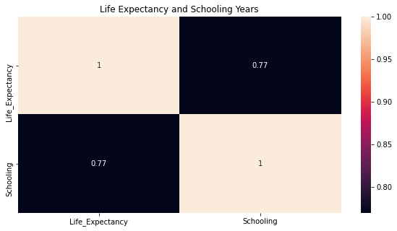
Effect of schooling on life expectancy

Slide 25
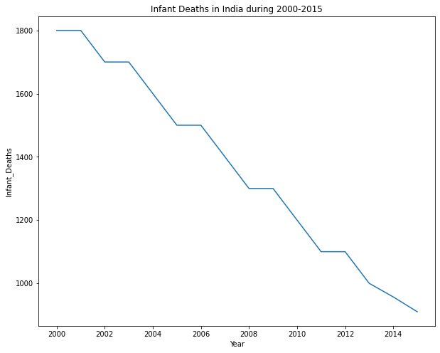
Infant death in India during 2000-2015

Slide 26
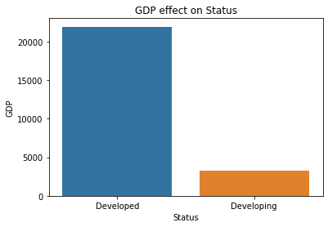
gdp and status

Slide 27
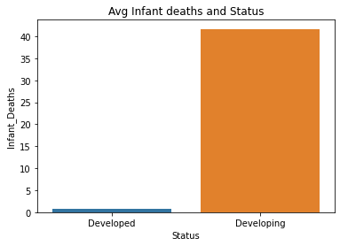
Infant deaths in developing and developed countries

Slide 28
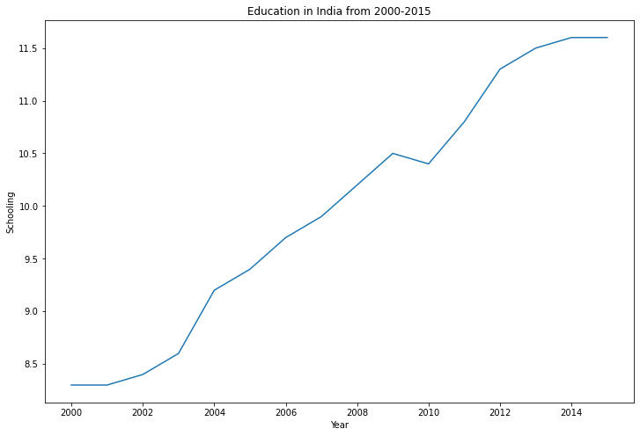
Schooling in India from 2000-2015

Slide 29
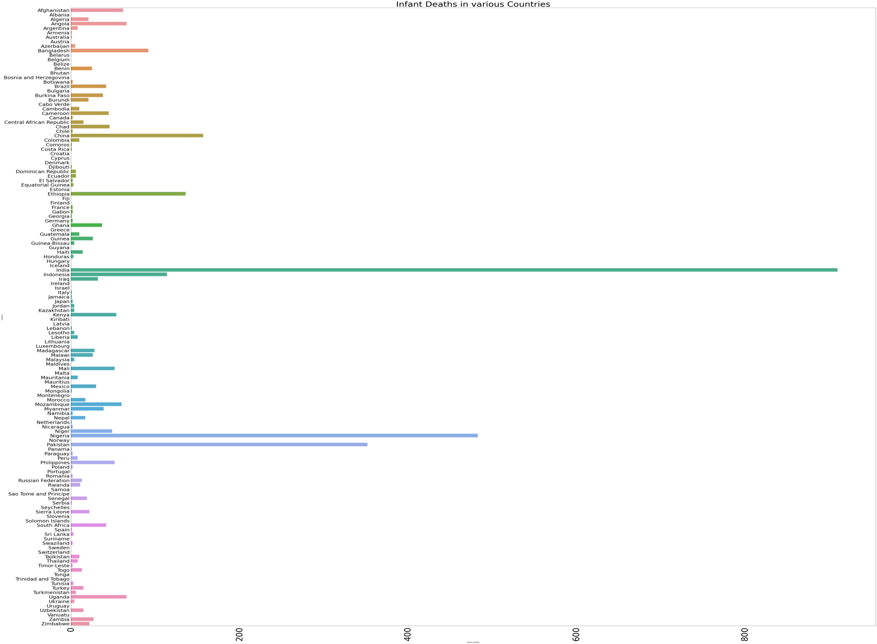
Infant deaths in 2015

Slide 30
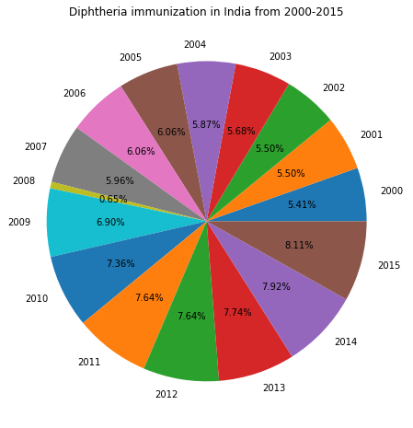
Immunization coverage in India from 2000-2015

Slide 31
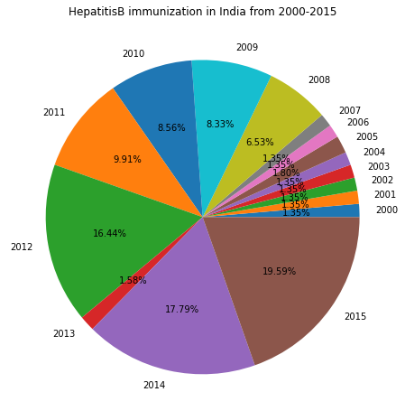
Immunization coverage in India from 2000-2015

Slide 32
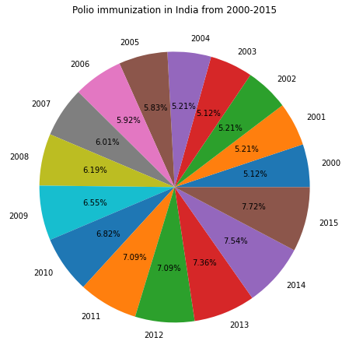
Immunization coverage in India from 2000-2015

Slide 33
conclusion

Slide 34
conclusion
There are different factors that influence Life Expectancy such as BMI and body diseases, thinness_1to19_years and thinness_5to9_years, Schooling and Income composition of resources and adult mortality.
So to increase the Life Expectancy of people, the Country should provide more immunization coverage and also contribute to its total expenditure in health care.
Moreover, increase in education also contributes to an improved life span of people among various Countries.

Slide 35
thank you

